Slide 1
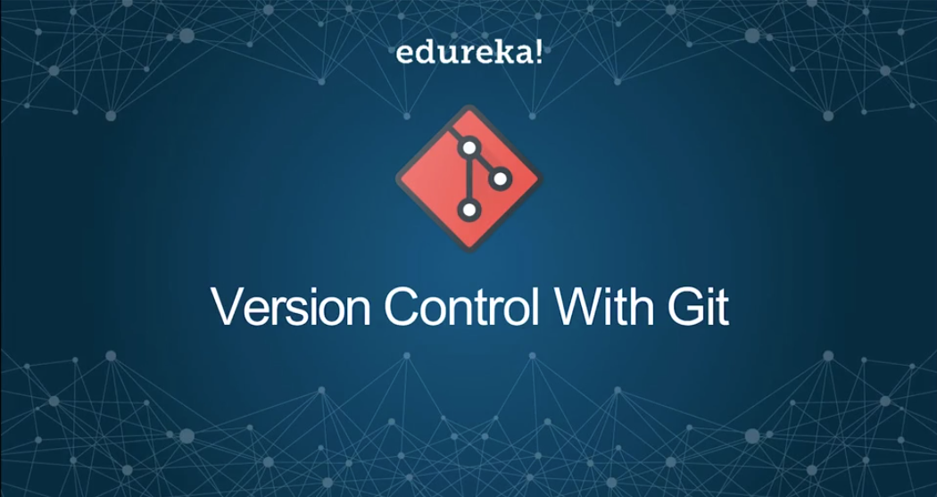

Slide 2
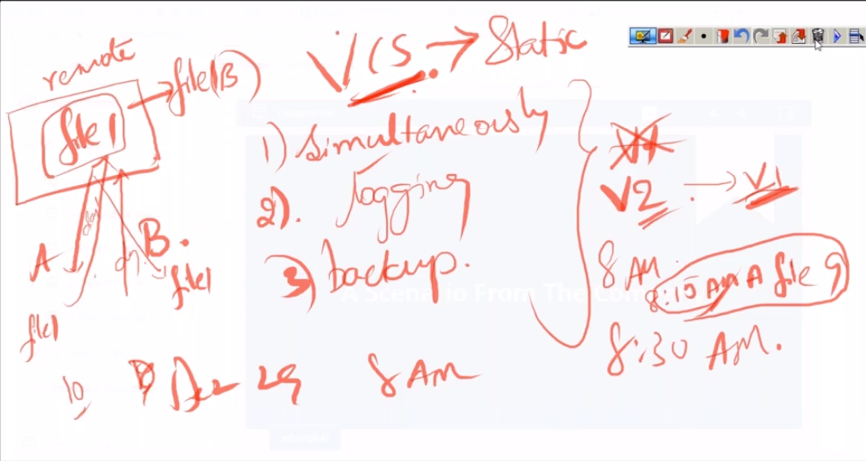

Slide 3
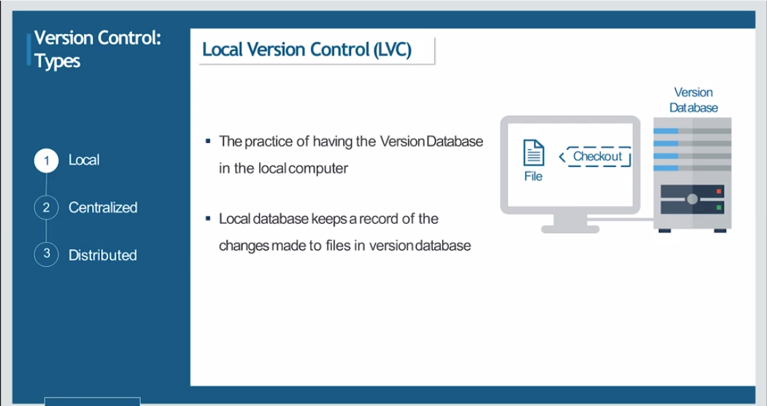

Slide 4
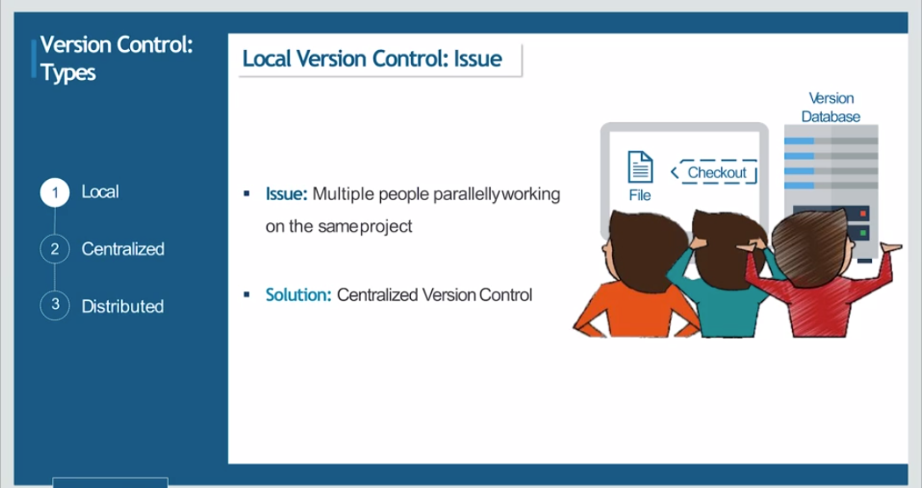

Slide 5
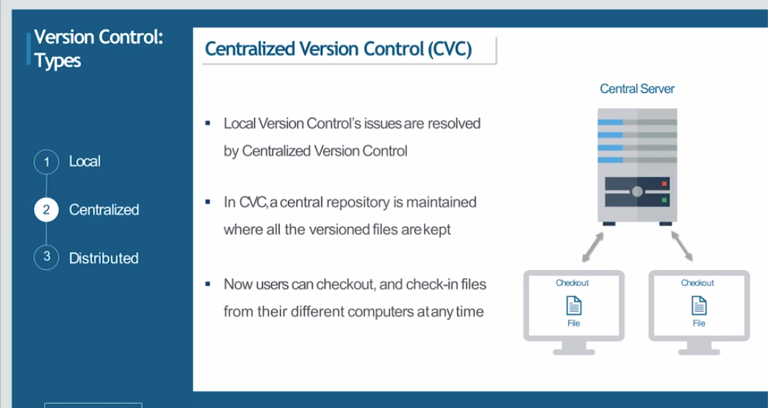

Slide 6
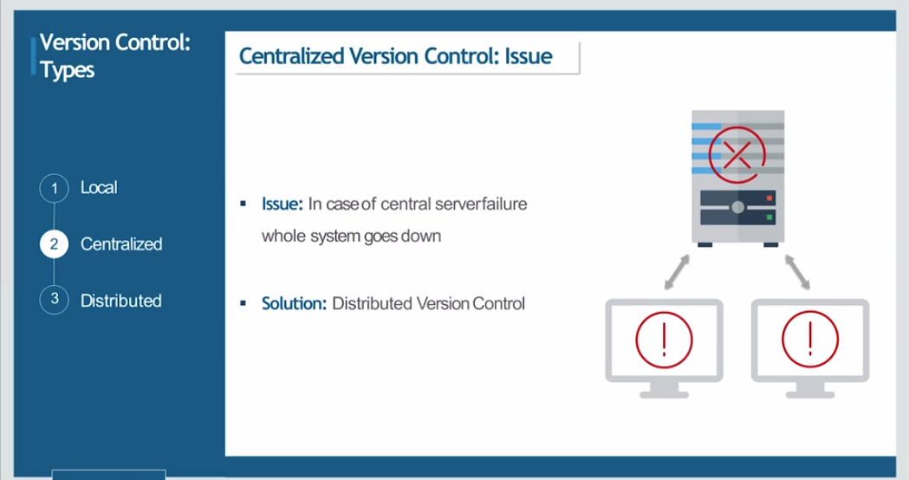

Slide 7
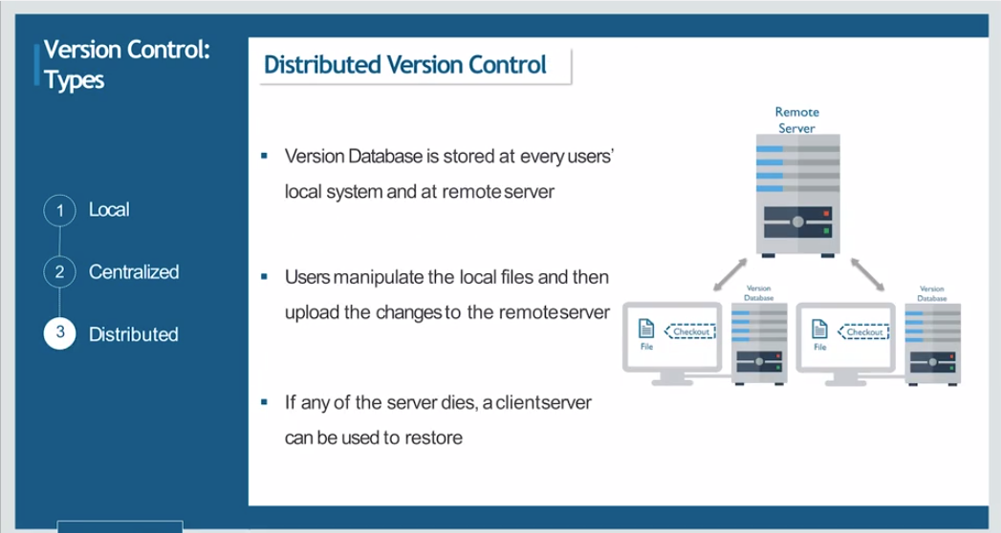

Slide 8
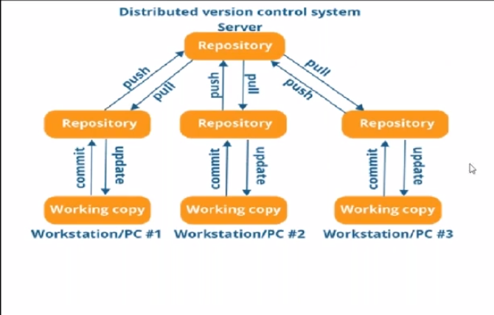

Slide 9
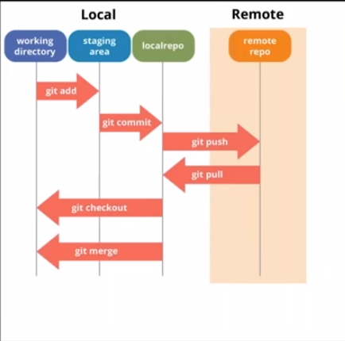

Slide 10
Working with Local Repo

Slide 11
Creating Files
Sudo su -
Yum install git / apt-get install git
git
Mkdir demo
Cd demo
Git config –global user.name “username”
Git config –global user.email “email”
git init
ll –al
vi index.html
git status
git add index.html
git ls-files
Git commit –m “First Commit”
Git status
Git log
Git log --oneline
Vi index2.html
Ls
Git ls-files
Git add index2.html
Git status
Git commit –m “Second Change”
Git status
Git ls-files
Git log
Git lof –oneline
Git show <commitid>

Slide 12
Editing Files
Vi index.html
Git status
Git add index.html -> git comit –m “msg” or
git add –am “mgs” -> for tracked/staged files

Slide 13
Diff Command
Vim file1.txt
Git status
Git add file1.txt
Git status
Git commnt –m “New File”
Vi file.txt
git status -----unstaged changes
Git diff file1.txt ….. Shows unstaged changes
Git diff –staged file1.txt ….. Shows staged changes
Git add
Git diff –staged file1.txt ….. Shows staged changes
Vi file1.txt
Git status
Git comit –am “changes”
The command to see the changes made to a tracked file

Slide 14
Remove File
Git rm file1.txt …..removes from working dir and local repo
Git ls-files
Git status
Git commit –am “”
Git status
Git rm –cached file2.txt …removes from local repo only
Git ls-files
Git status
Git commit –am “”
Git status
Git log --oneline
Gitignore
Vi .gitignore ….remove tracking for the files

Slide 15
Undo a commit
Git log –oneline
Git revert <commitid>
Git log –oneline
Git revert <revcertID>
Git log –oneline
Ll –al
Git status
HEAD -> Points to the topmost commit

Slide 16
Reset Command
Used to alter the Head
Git log –oneline
Revert created a new commit ID
Rebase does not create a new commitID
Git reset –hard <commitID>
Git log –oneline
Desctructive Command
Git reset --help

Slide 17
Branching & Merging
Need for Branches
Features per branch
Parallel Development
Release Management
Git branch
Git checkout –b newBranch master
Git checkout –n newBranch
Git Branch
Git status …on Branch….
Git log –oneline newBranch
Git log –oneline master
Create files in new branch
Git status
Git add
Git commit –m “”
Git statis
Git log --oneline <branch>
Git log --oneline –master
Git checkout master
Git status
Git merge <source> <<destination>>
Git logs –oneline

Slide 18
Merge conflicts
Create a file on master
Git checkout newBranch
Make a new same file like master
Gt merge newbranch master
Launch the file that has conflict
Vi file
Edit the file as per need by deciding which changes to keep
Git add –am “”
Git merge newbranch master
Git status

Slide 19
Working with remote Repository

Slide 20
Stashing
Shash – changes in the working directory moved to a temporary shelves and cleans the working dir
Unstash – get the changes back from the temporary shelves back to the working directory
Ls index1.html
Git status
Git stash
Git status
Git stash list
Git show <Stash number>
Unstashing
Git status
Git stash list
Git stash pop <StashNumber>
Git status
Got stash list
Git stash clear
Git stash list
Git stash –p
Asks which files to stash
Git stash list
Git stash pop <stash number>
Git show <stashNumber>
Git stash drop <stashNumber>

Slide 21
Rebase
Used rarely
Used to merge the branches but
Does not create a new commit
have two commits on the master
Git checkout –b b2
Git checkout master
Create additional commits on master
Git checkout b2
Create additional commits on the master
Git logs –oneline b 2
Git branch ---------check if you are on b2
Git rebase master
Git logs –oneline b2
---------Name Commits as “A” “B” for Merging and rebasing tutorials

Slide 22
Push to remote repo
Create a remote repo on githu.com
Got remote add origin “gitrepoURL”
Git push origin master
Git push origin b1
Git branch –d branchToDelete
Git branch –D branchToDelete
Git push origin –delete b1 ---delete branch from remote repo

Slide 23
PULL, FETCH, CLONE
Git clone “gitURL”
Ll –al
……… check that .git is created
Create a file
Commit changes
Git push origin master
Create a new file in github directly
Git pull origin ----update local repo with remote
Git fetch origin …..fetch
Clone – First time getting a repo
Pull – update local with reote changes by downloading- Merge changes-It gets the changes made in remote repositoiry and copies them to local repositoiry and and merges them to working directory
Fetch – shows changes, It gets the changes made in remote repositoiry and copies them to local repositoiry, but not merged these changes to the working directory
Pull = Fetch + Merge

Slide 24
Merge conflict from remote
Change a pushed file contents on a branch
Ensure those changes are not there on local
Change the same file on local so as to create a merge conflict at the file content level.
Git push origin master
Creates a merge conflict
Error
Make sure before push the local repo is updated with the latest changes
Git pull origin master
Merge conflict
Vi conflictfile
Remove all the verbose content generated by git

Slide 25
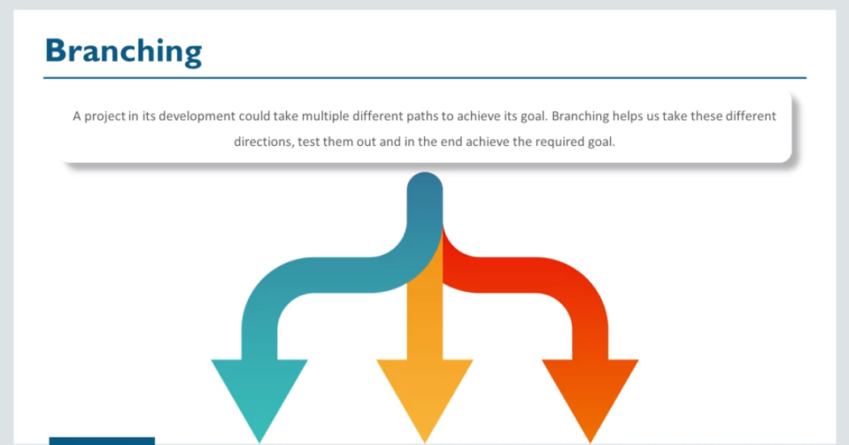
Git – Branchng and Merging

Slide 26
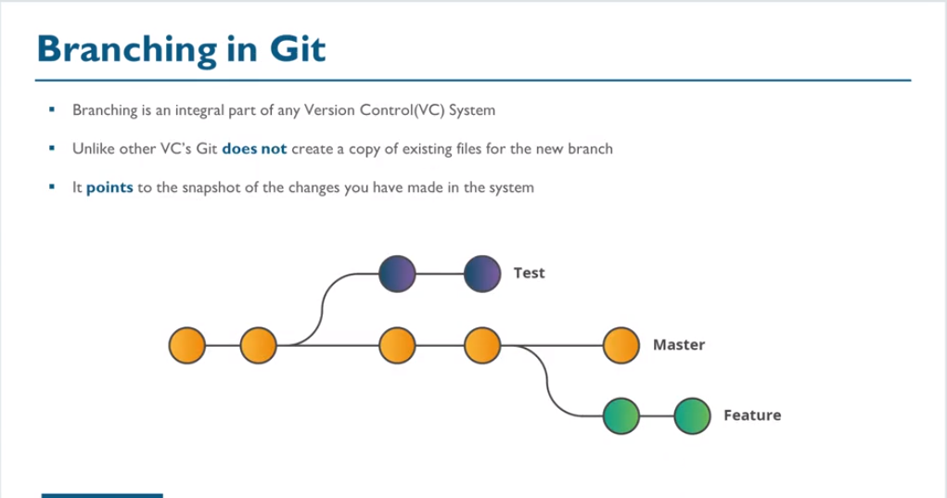

Slide 27
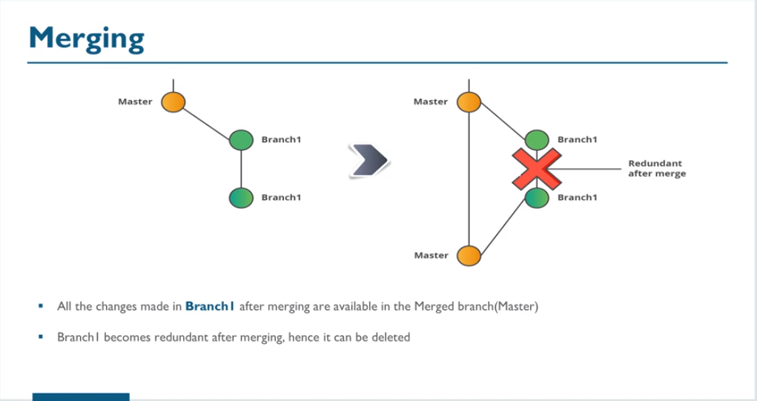

Slide 28
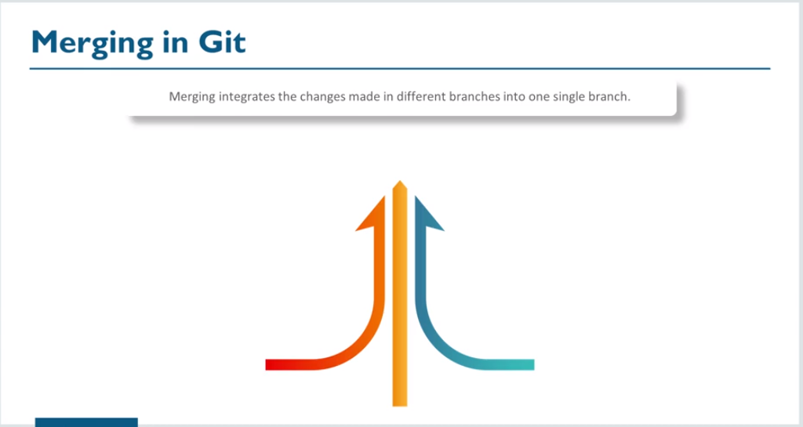

Slide 29
Demo
Git branch feature2
Git branch -------------shows all branches and current one
Git checkout master
Ls
Git checkout feature2
Edit some file
Stage and commit the file
Open branch the master and view the same file and verify that master does not have the changes
Git merge feature2
Open the changed file and verify the changes got merged in the master branch

Slide 30
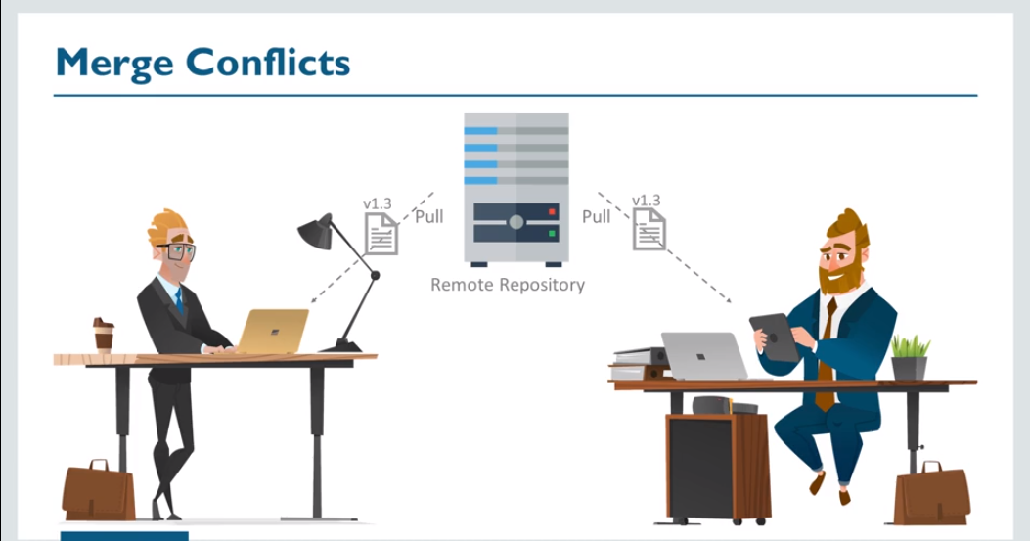

Slide 31
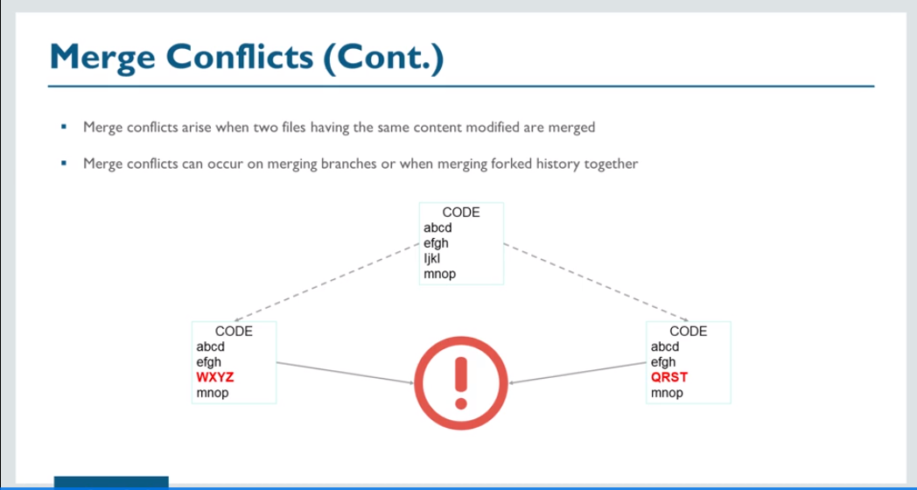

Slide 32
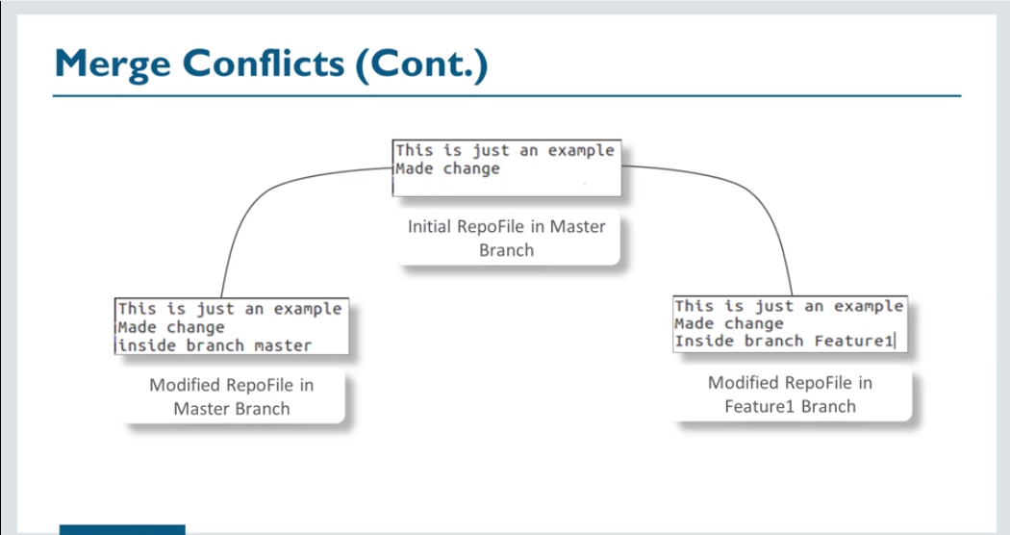

Slide 33
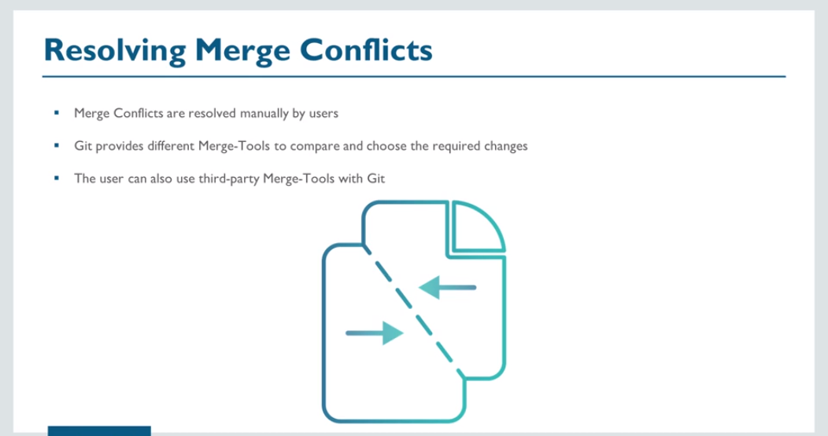

Slide 34
Demo
Create a file on a master branch
Create a branch
Modify a file on a feature branch
Change to master
Modify the same exact file at same line
Merge the feature branch with the master
Git merge feature
View the merge conflict
Git mergetool???
Handle the merge conflict

Slide 35
Advanced Git Operations
Stash, Rebase, Revert, Reset

Slide 36
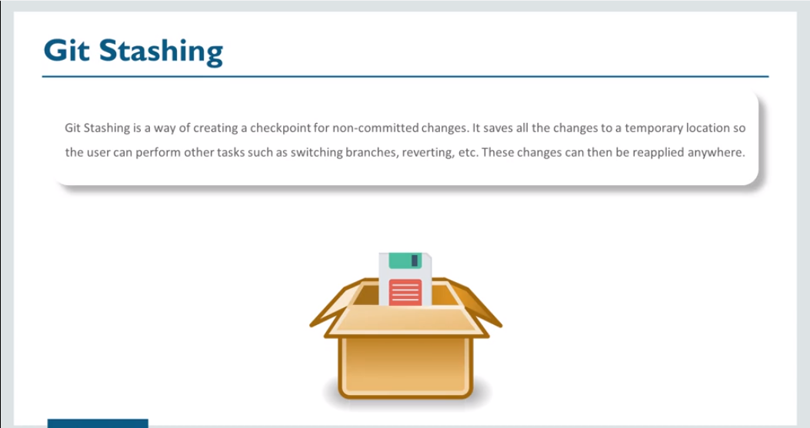
Stashing and rebasing

Slide 37
Git stash save “first stash”
Git stash list
Git stash apply <stashID>
Git stash drop <stashID>
Git stash list

Slide 38
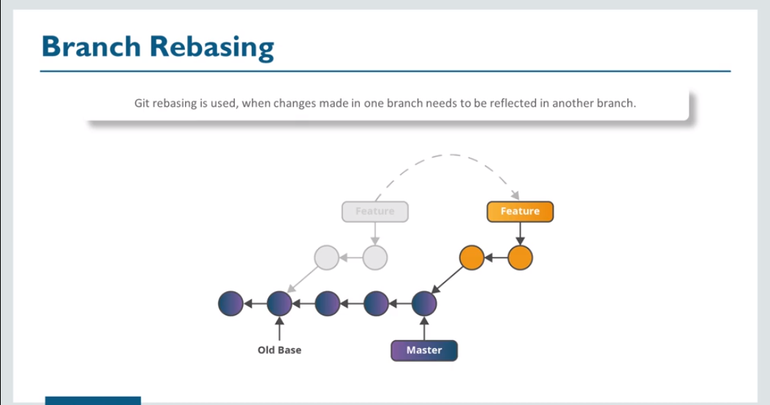

Slide 39
Rebase Demo

Slide 40
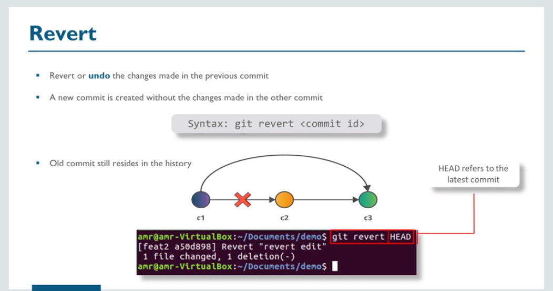

Slide 41
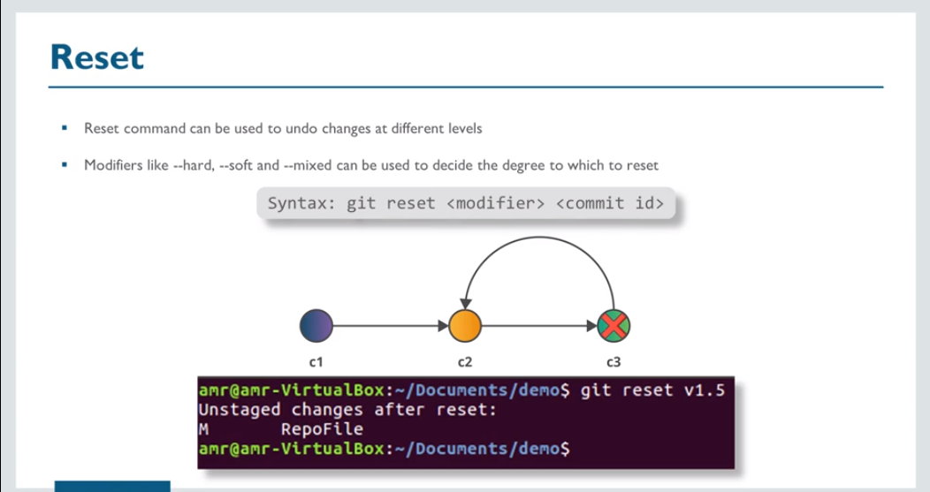

Slide 42
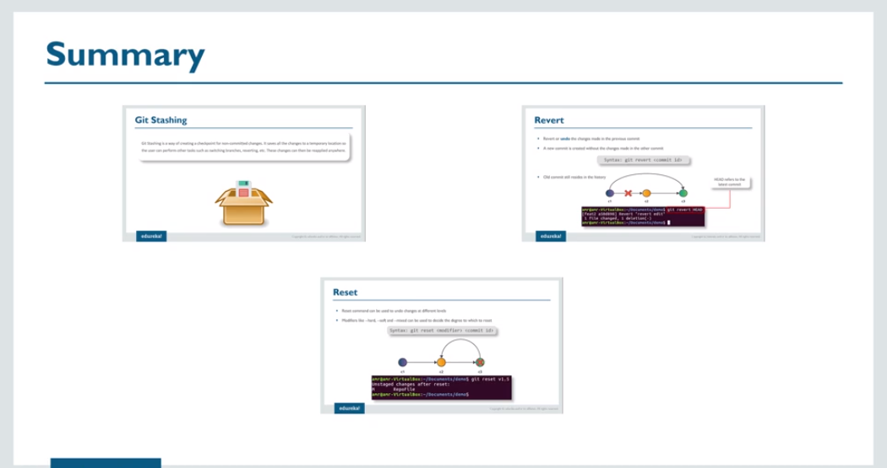

Slide 43
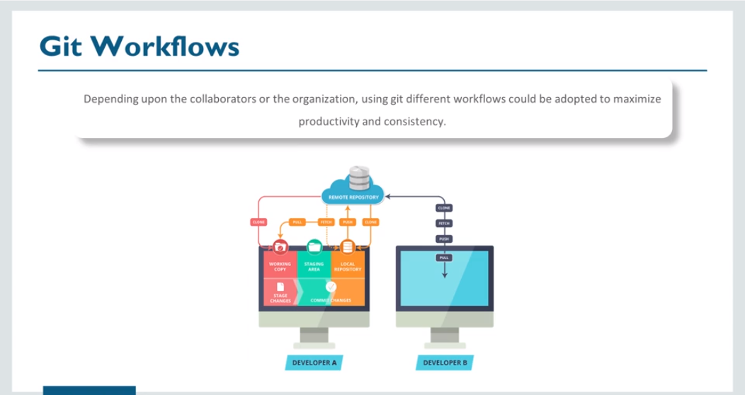

Slide 44
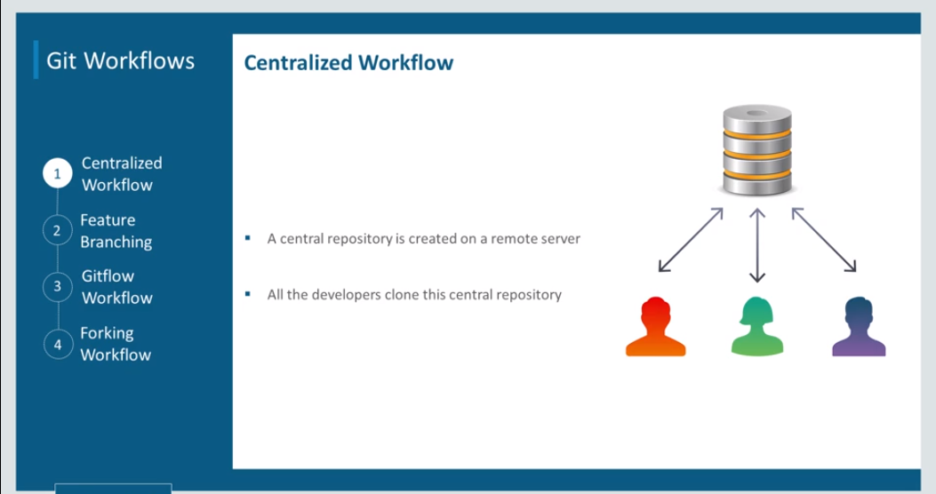

Slide 45
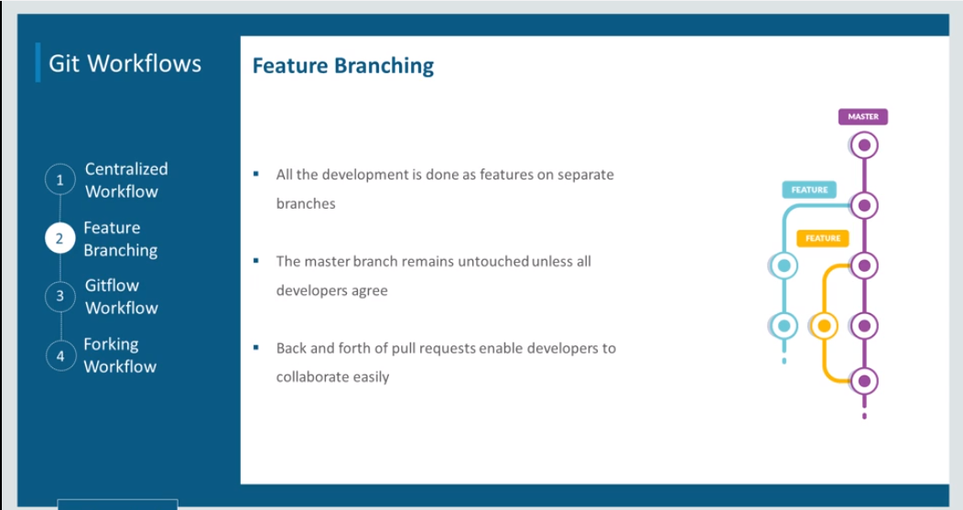

Slide 46
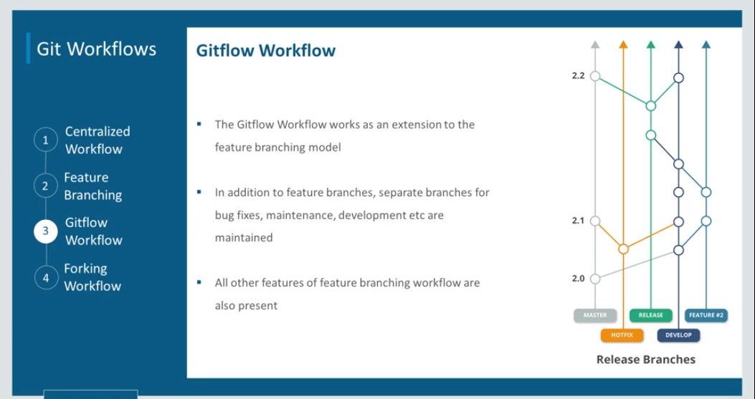

Slide 47
